Slide 1
Project Hints
From instructions – “A comment can belong to any number of classes, including none.”
I.e. each prediction is independent.
IDs in the output should be 1,2,3,4,5… in the order of the original data in the test file.
Final output data is just a compilation of predictions:
Predict each value of the test set.
Combine text and predictions into dataframe, according to instructions.
You are effectively adding 6 target columns – each filled with predictions.
Print to csv.
Check formatting to make sure file runs.
Overall accuracies will probably be pretty high, score grades distributed logarithmically.
Tip - think about why we train/test split, what the accuracies mean, the names of the two files you’re provided, and what we’d want to do to predict real new data most accurately.

Slide 2
Today:
Saving trained models.
More clustering.
Gaussian Mixtures
Generating data
Clustering assignment intro.

Slide 3
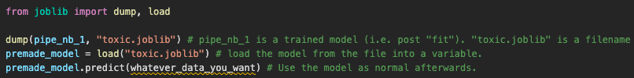
Saving a trained Model
Some models take a long time to train.
Doing this over and over can be wasteful.
We can save a model to disk and load it without redoing the training.
The common library “pickle” does similar things, but sklearn recommends joblib.

Slide 4
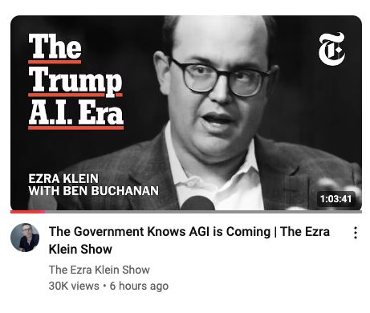
Today in AI
I saw a podcast today, it argues that AGI is coming within a couple of years.
US oligarchs demand investment and less restriction to beat China. (If China has AI first it’s scaryyyyy!!!!!!).
Negative impacts will be ignored for “we must dominate”.
I really don’t think we get AGI anytime soon.
We don’t really know how to define intelligence.
We don’t know what/how to get there.

Slide 5
Clustering

Slide 6
Supervision
The algorithms we’ve looked at until now have been supervised.
All classification and regression algorithms.
In machine learning supervised vs unsupervised refers to if we know the outcomes (labels) beforehand:
E.g. in classification we don’t know the outcome for each record, but we do know the classes.
Unsupervised algorithms don’t have a preset domain of outcomes.
Clustering will group things together, just like classification will, but we don’t know what each class/category is.

Slide 7
Unsupervised Learning Applications
Clustering - data mining technique for grouping unlabeled data based on their similarities or differences.
Association - unsupervised learning method that uses different rules to find relationships between variables in a given data set.
Frequently used for market basket analysis and recommendation engines, “also bought…”.
Dimensionality reduction - used when the number of features (or dimensions) in a given data set is too high.
Reduces the number of data inputs to a manageable size while also aiming to preserve the information embedded in the data.

Slide 8
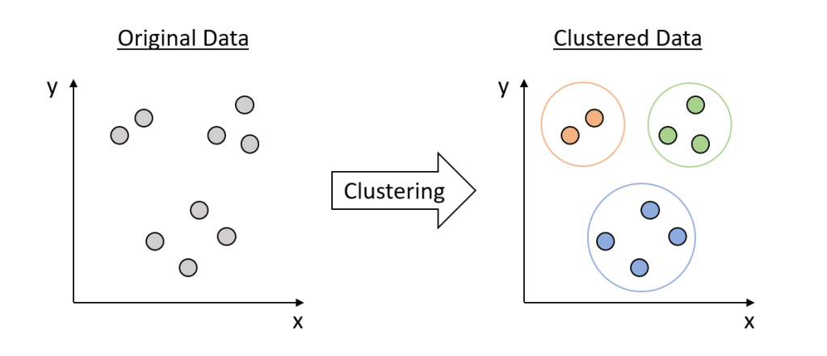
Cluster Basics
Clustering algorithms group records based on their similarity.
We don’t have a label for the resulting classes – they’re just 1, 2, 3…
There are several methods of determining similarity – I,e, different algorithms.
Similar to how we have multiple classification algorithms .
The idea of accuracy changes – we don’t have a test set.

Slide 9
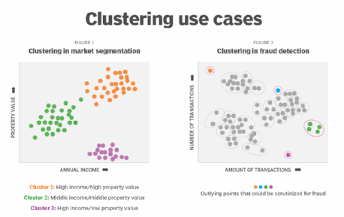
Why Cluster?
Clustering is used in several ways across ML.
Creating similar groups. (e.g. group millions of bank custys into segments).
Exploration – are there natural groups in data.
Assisting supervised models. (e.g. if you have unlabeled data, group them into clusters, manually label each cluster, then do classification).
Identifying anomalies. (e.g. fraud detection – things that don’t fit into groups.)

Slide 10
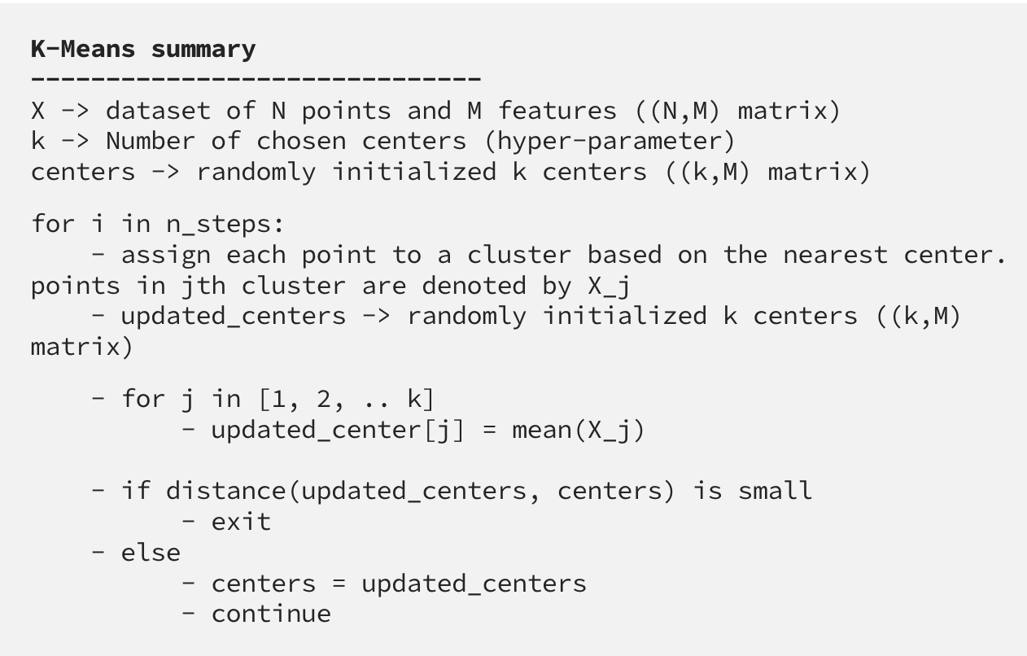

K-Means
K-means is a common and simple clustering algorithm.
Algorithm creates clusters that minimize distance from center.
Make k center points (wherever).
Assign each point to the closest center’s cluster.
Move the center of each cluster to the new center.
Repeat until progress stops.

Slide 12
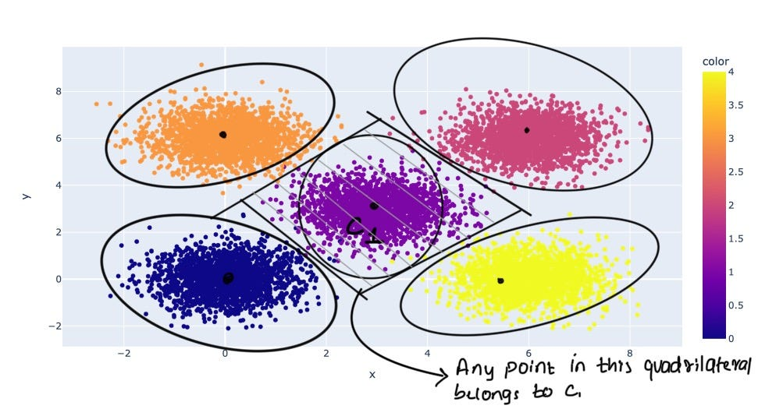

Slide 13
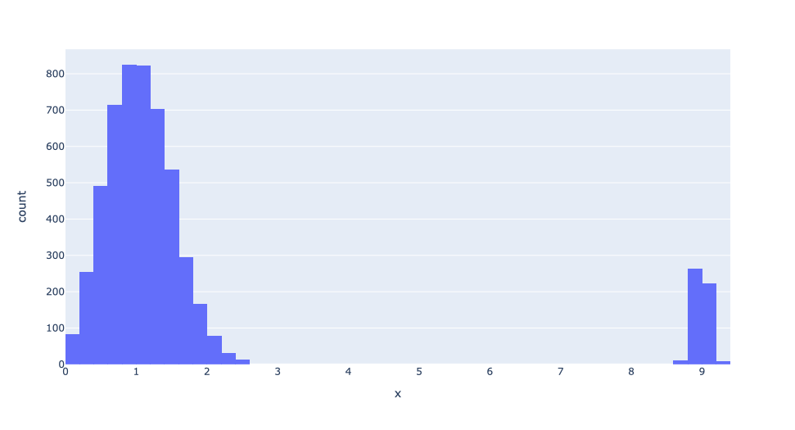
K-Means Limitations
K-Means carries a similar set of limitations to linear models.
K-means makes clusters that are round-ish in N dimensions (‘globular’). Weird shapes perform worse.
K-Means is highly impacted by variable scaling and outliers.
Higher k may be able to cluster outliers together.
Distance calcs are impacted similar to regression.

Slide 14
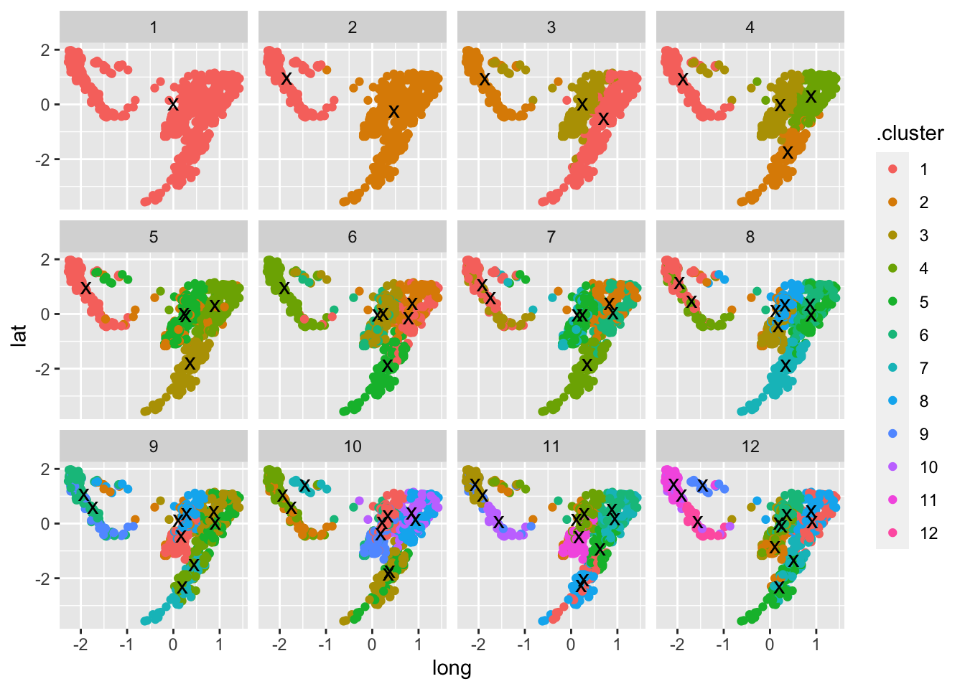
Totally Globular, Man!
K-Means will struggle with non-circular data.
HP options may help, but this is inherent to the functionality of k-means.

Slide 15
Quantas Clusters?
An unsupervised algorithm doesn’t really have accuracy like a supervised one.
For each clustered item, we have no answer to compare to for test accuracy.
We need to define some other metric for ‘good’.
In this case ‘compactness’ is a good start.
Ideally, we want tight clusters far from each other.
Let’s think of 3 possible criteria:
Largeness --> number of points in the clusters.
Density --> Average of distance of two points in a cluster.
Separation --> overlap between two cluster.

Slide 16
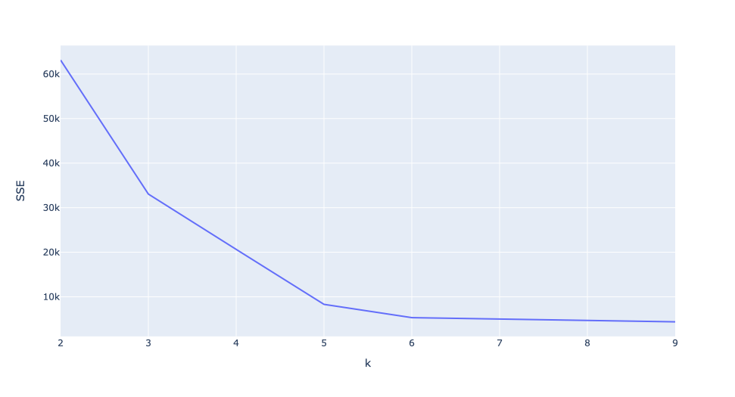
Density and Size
Cluster size is simple – we want clusters that are big enough, not just a few items.
Tiny clusters are more dense, but might not make sense in most scenarios.
Density is basically just the SSE.
Less distance between point and center.
More points in small area.
We can plot it with an elbow plot.
Generally, we want the point where it flattens.

Slide 17
Overlap – Silhouette Score
The silhouette score gives us a metric for overlap between clusters.
Rages between -1 and 1, large score = less overlap.
Formula and calculations:
a = Average intra-cluster distance of p with all the points in the same cluster . .
b = Average distance of p with any cluster that is not the one p belongs to. If there are N clusters, we get N-1 such averages. Take the minimum of these and call it b.
silhouette-score for p = (b - a)/max(b, a)
To get a score on a cluster level, average the scores of each point.

Slide 18
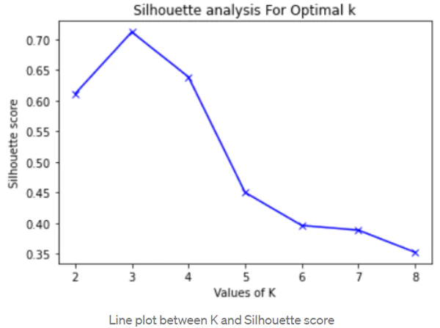
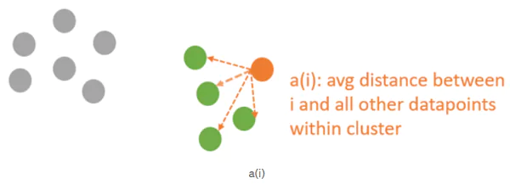
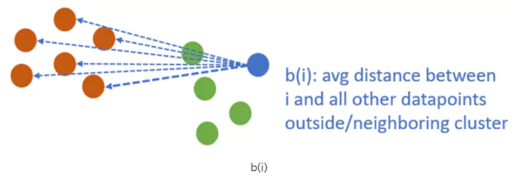
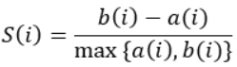
Silhouette Scores
The score basically measures a ratio between distance internally and distance externally.
1 is good, near or less than 0 bad.
We can combine this with the elbow and domain knowledge.

Slide 19
Clustering Process with k-Means
Choose a range of number of clusters that’s reasonable.
Test the cluster results for each.
SSE elbow plot.
Silhouette score plot.
If data is massive, you may want to sample.
Combine those results with domain knowledge to choose k and finish.
E.g. if you know that you can have up to 8 customer segments, that’ll impact the choice even if some larger number is mathematically optimal.

Slide 20
Projection Problems

Slide 21
Detour - Projecting Clusters in 2D
In many cases we like to look at the data we are clustering in 2D.
Most of our data has more than 2Ds – what do we do.
Either reduce dimensions by just picking two, or project down.
PCA is one example of projecting down to lower dimensions.
Deconstruct features and reconstruct the important bits into fewer components.
PCA is linear, so it works better with linear relationships in data.
If we have non-linear data, we can use other tools that may fit better.
t-Distributed Stochastic Neighbor Embedding

Slide 22
t-Distributed Stochastic Neighbor Embedding
tSNE is dimensional reduction that works differently from PCA.
tSNE is not linear and is based on probability.
PCA maintains the variance explained in the data. (I.e. predictive value).
tSNE aims to maintain the ‘pairwise similarity’.
More on probabilistic clustering in GMMs next time.
tSNE is commonly used to visualize and understand high D data in 2D.
Key HP is perplexity – controls how ‘far’ the algorithm will look at data.
Higher values makes it look at farther points to construct structure.
tSNE can be slow – sometimes other prep like PCA may be used first.

Slide 23
Agglomerative Clustering
An alternative approach to clustering is agglomerative clustering.
Starts with clusters of n = 1.
Merges clusters until the specified # of clusters is reached.
Most similar clusters merge to one cluster.

Slide 24
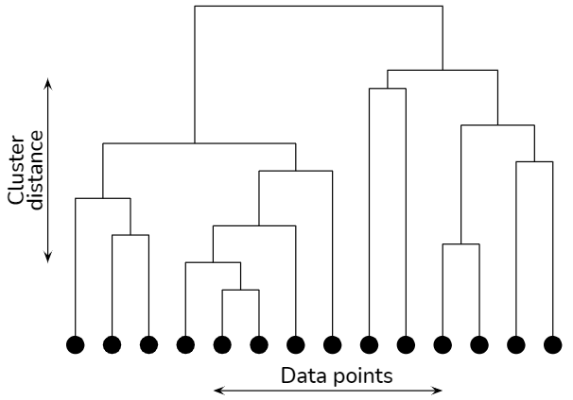
How many Clusters
Like with k-means, we can perform calculations to advise us on the best number of clusters.
A dendrogram is a way to visualize agglomerative clustering.
The greater the distance between the clusters, the longer the vertical lines of the dendrogram.
Graph measures the number of clusters vs distance.
The ‘best’ is where a line can cross the longest stretches of vertical lines.

Slide 25
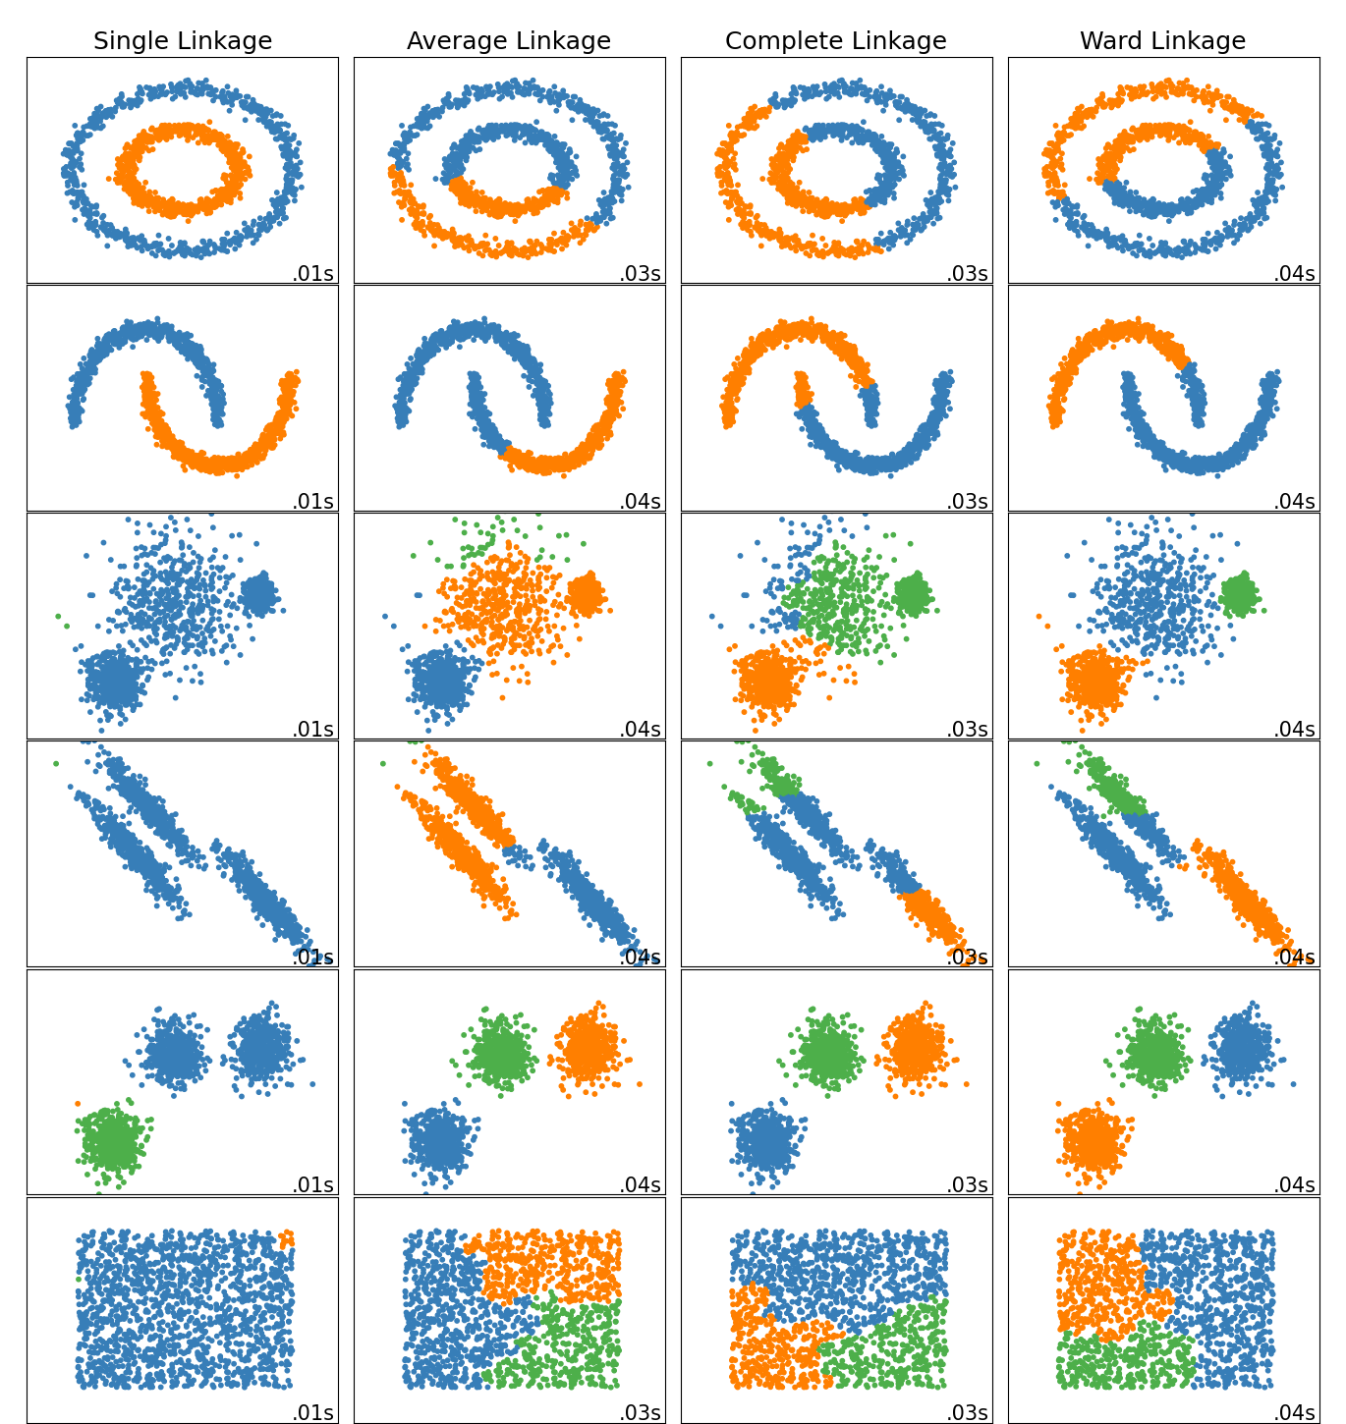
Linkages
In agglomerative clustering the linkage is a big factor in fit for data shapes.
The connectivity provides a similar set of differences.
Agg. Clusters can trend towards ‘big clusters get bigger’ by default.

Slide 26
Agglomerative Clustering +/-
AC is relatively simple to understand, but can be slow.
Cluster distances need to be constantly recalculated.
Visualization with the dendrogram becomes difficult as data size increases.
Clustering relationships different from k-means can be accommodated.
Roughly the equivalent to a tree vs a regression – can handle non-linearity.

Slide 27
Cluster my Features
One alternative thing that AC can do is act as a feature selection.
Sklearn library is FeatureAgglomeration.
Features can be merged for similarity, resulting in a smaller feature set.
Alternative approach reduce dimensions of data.
Think of a regression model that predicts fuel economy of cars.
Likely have features for engine size, cyl, hp, tourque, bore, stroke, etc…
Could group those into on feature – ‘engine’.
Combine with another for size, etc…
Likely to perform best in multicollinearity scenarios – many features containing similar info.

Slide 28
Clustering in a Feature Pipeline
Clustering (of any variety) can also be used in preprocessing for supervised learning.
Can condense a large number of features down to a simpler few.
Can help extract hidden patterns in the data.
Clustering is learning, and the estimator is also learning.
We’ll see a more clear/obvious look at this concept when we do neural networks.

Slide 29
Clustering as Preprocessing – Semi-Supervised
Example Process:
Cluster data into clusters of similar points.
Use those clusters as feature set for classification or regression.
Example (in workbook) – classifying digits:
Group digits into similar groups.
Predict number value from the groups.
In cases where we only know SOME of the labels, this can help us by propagating those labels.
Cluster items, spread the known labels to rest of clusters, predict with full label set.
We can employ people to provide the ‘some’ part, and let the model do the rest.

Slide 30
Using Clusters in Practice
If our end goal is clustering some data, we likely need to test and evaluate algorithms.
There isn’t a clear error metric, we need domain knowledge evaluation.
Metrics indicate ‘mathematical compactness’ (or similar), but that may not match real use.
Likely also need to test different # of clusters, with metrics just acting as a guide.
There’s other clustering algorithms out there, probably should try those too.
Hyperparameter tuning our clusters:
There are several hps that can impact the performance of clustering.
K-means – initialization and algorithm.
Agglomerative – linkage, connectivity, distance_threshold.
Different data tends to yield wildly different results…

Slide 31
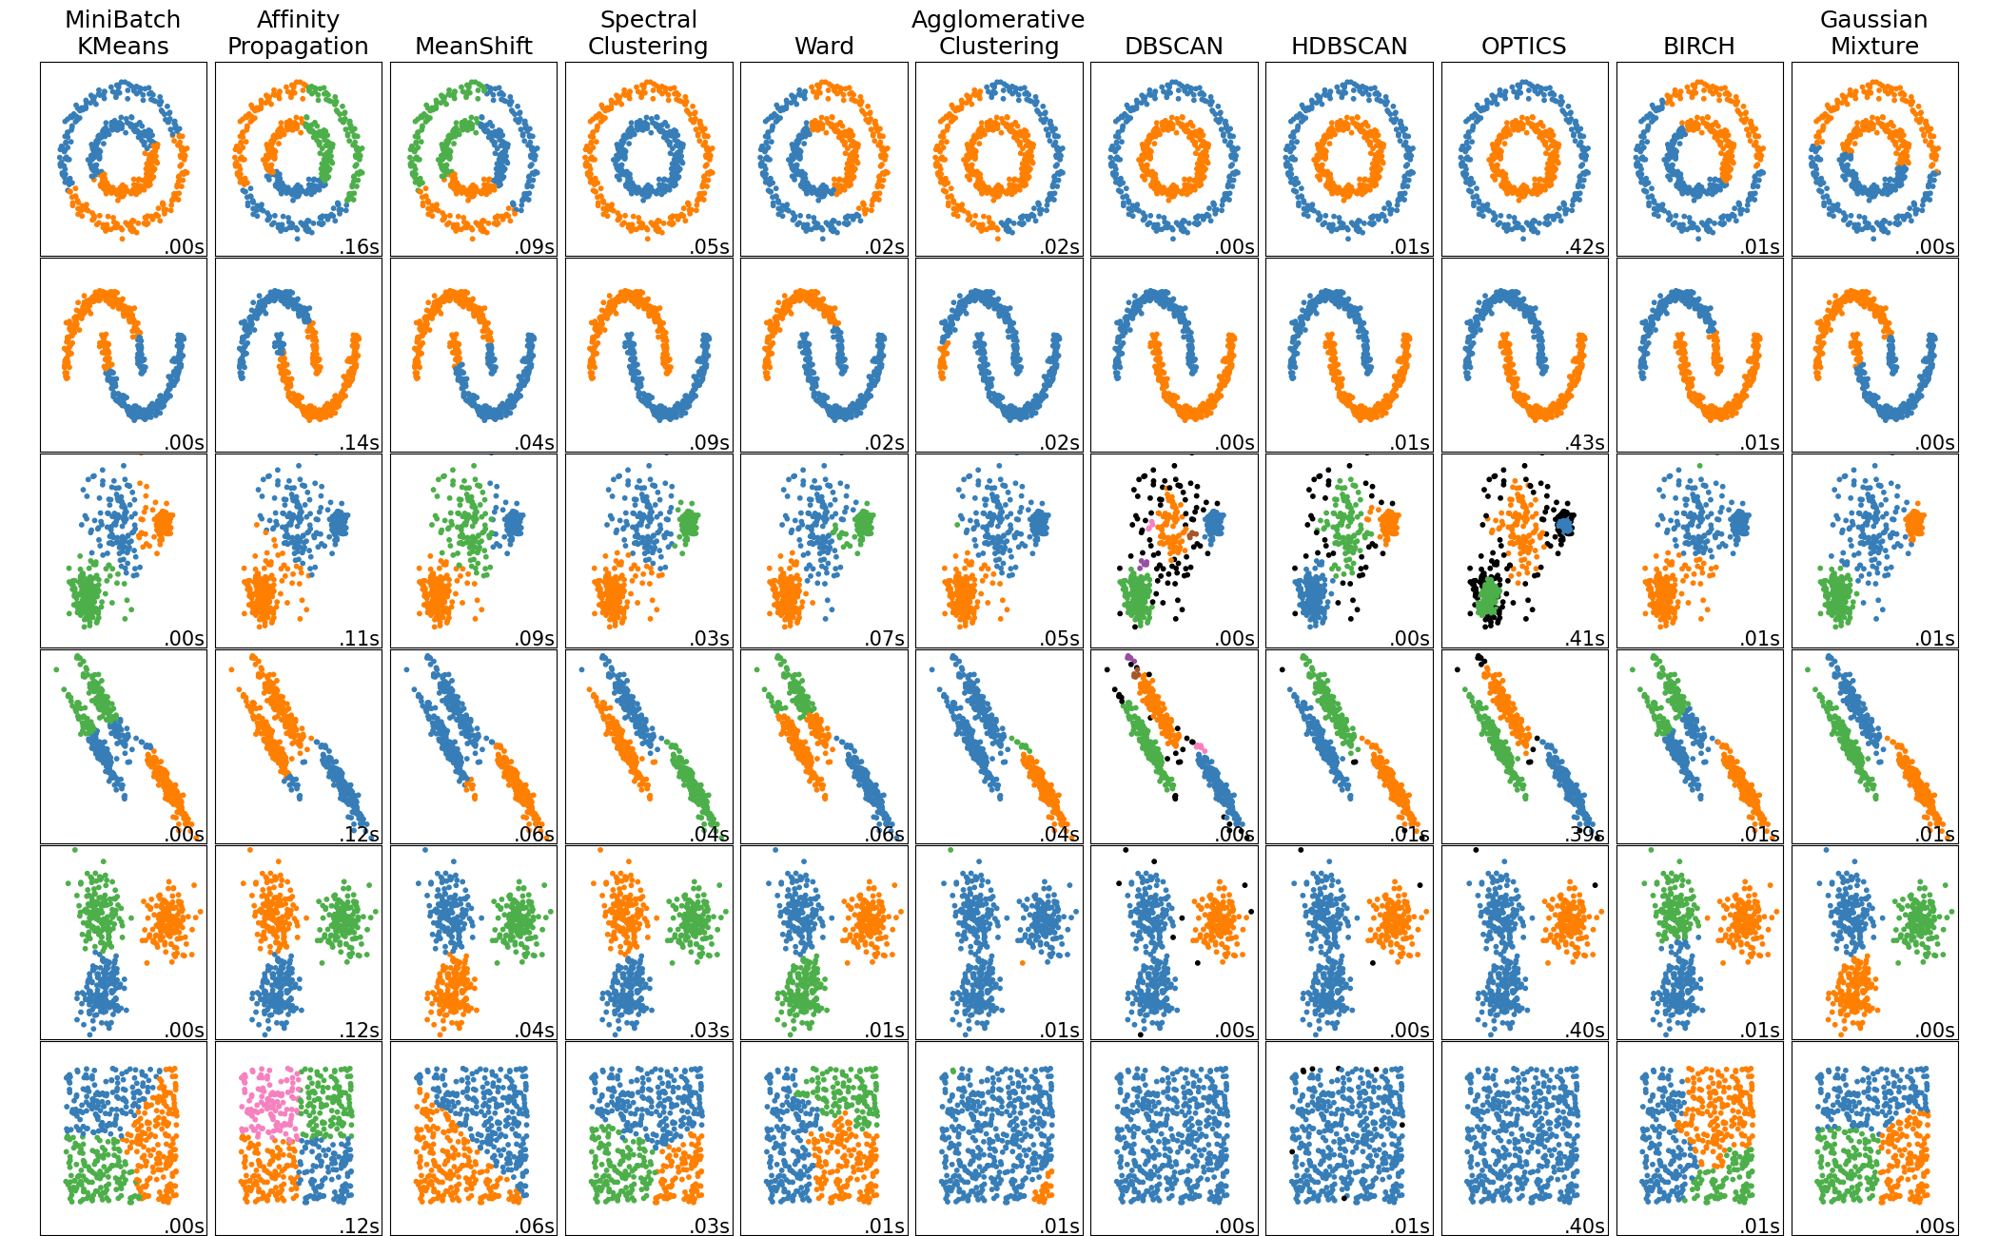

Slide 32
Expectation Maximization
There is another class of clustering algorithms based on probability.

Slide 33
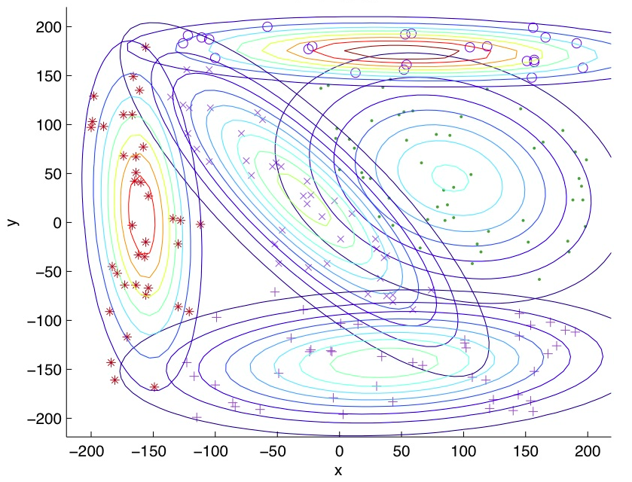
GMM – Gaussian Mixture Models
GMM is another clustering technique.
GMM is probability based:
Data is more likely to be located in the middle of a cluster.
Data is less likely to be located around the edge of a cluster.
The distribution is Gaussian, or normal, lots of results in the middle of the distribution, less at the tails.
Can accommodate different shapes vs k-means which is circular.

Slide 34
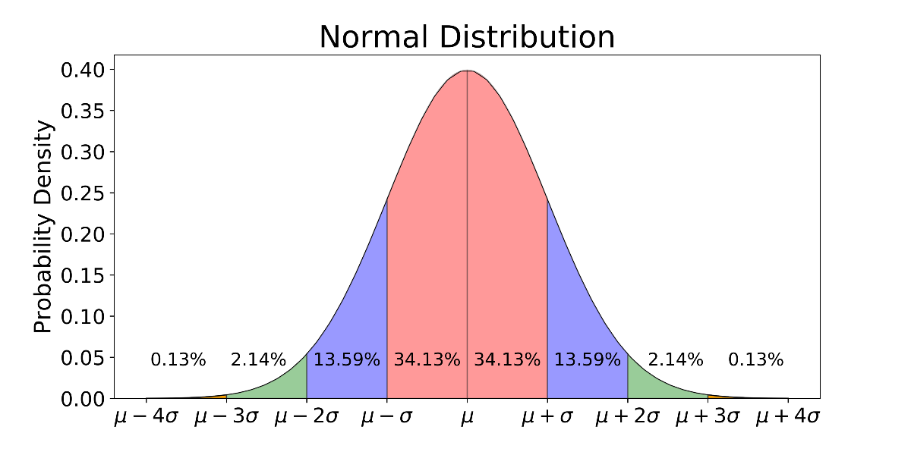

Slide 35
(Some Basic) GMM Math
Each GMM is made up of a set of functions, one per cluster.
A mean μ that defines its center.
A covariance Σ that defines its width. This would be equivalent to the dimensions of an ellipsoid in a multivariate scenario.
A mixing probability π that defines how big or small the Gaussian function will be.
We get a set of formulas that define the expectation for where points lie.
Equivalent to an analytical distribution in stats.
The model is the probability formulas themselves, not any of the data or labels.
Calculating this stuff is a very big headaches, and we don’t want to or need to.

Slide 36
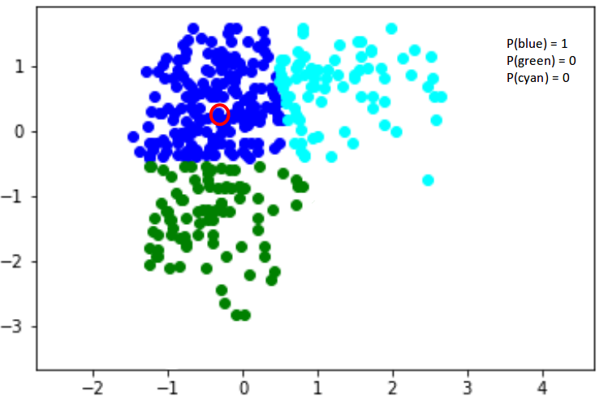
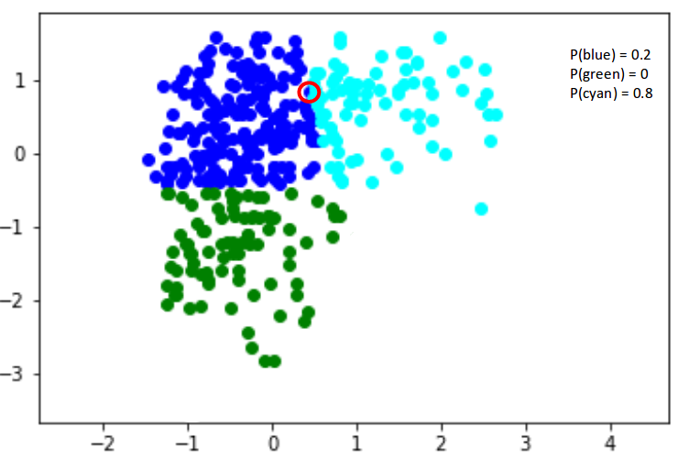
Cluster Membership is probabilistic
Each cluster is one equation that defines the probability of where its points lie.

Slide 37
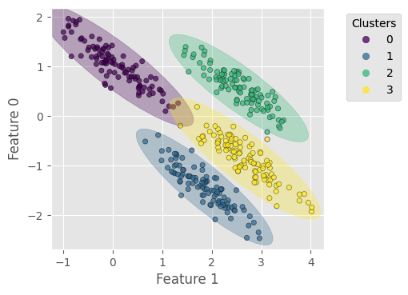
GMM Clusters
We can have clusters that overlap.
Each cluster has a certain probability of containing a point in that location.

Slide 38
GMM Uses
Anomaly detection:
GMM is commonly used to identify anomalies.
The idea is similar to outliers in a stats distribution.
We expect data to be clustered according to a distribution, we can set a threshold of how far out something needs to be to be an outlier/anomaly.
Useful in things like fraud detection.
Generative:
Due to the probability aspect, GMM is Generative.
If we have a probability distribution of the data, we can create data that fits that distribution.

Slide 39
Generative models – The New Hotness
Generative models vary, but the core idea is the same:
Learn the expectations of what the data is during the training process.
Construct some sort of mathematical/formulaic representation of that expectation.
Generate examples by asking the model to create from that representation.
In LLMs models predict an embedding vector, then choose a close word.
The model knows what type of value it predicts (1 vector), that’s translated into an answer.
With GMMs, the model learns the expected probability density of the points.
We can ask it to create new data that follows that distribution.
We’ll do it with images, that’ll be an assignment for you.

Slide 40
Anomaly Detection with Clusters
Anomaly detection is a common use of clustering, and quite intuitive.
For example, a bank processes millions of transactions:
Most fall into common patterns – ATM, mortgage payment, credit card bill, etc…
Some are weird, and don’t fit those patterns.
Might be uncommon (big wire trans.), actual fraud, or random – but need investigation.
In Sklearn, there’s a separate anomaly set of functions, so we don’t really reuse clusters.
We can calculate distance and threshold manually, if we really wanted to.
Can also prune outliers, train models, then check fit (for GMMs).
The algorithm needs to change a bit to filter out things that aren’t clustered (by HP or man.)

Slide 41
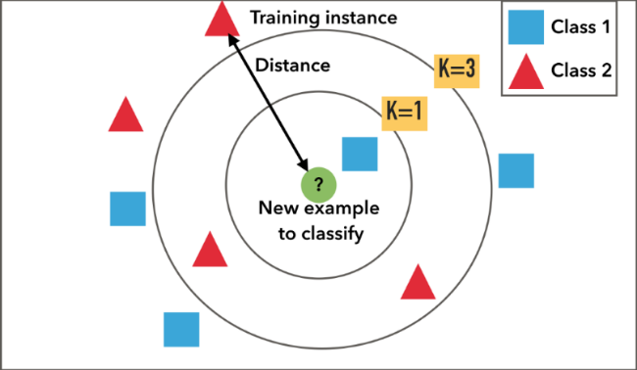
Clustering’s Buddies - kNN
K Nearest Neighbors is an algorithm that is not k-means clustering, but is similar.
kNN is a supervised algorithm that does classification and regression.
kNN works by finding the k data points that are closest to the new point:
For classification, most frequent class wins.
For regression, mean of the class.
Most useful for things like recommendations – if someone wants Movie X, which others are close?

Slide 42
kNN and Imputation
One good application of kNN is imputation – try it from the docs!
We can replace the mean/median strategy of generating a value with kNN.
The imputed value is determined by kNN. For example:
Data is census type data of the population – age, salary, kids, address, etc…
Some income data is missing.
Median imputation puts in the median value for every record.
kNN imputation puts in the mean of the most similar records, based on the other features.
I.e. what is the average salary for people in similar locations, of similar age, etc…
Can be a smarter and more targeted method of imputing data.

Slide 43
Conclusion
Clustering is very useful in many scenarios, particularly when exploring.
Can be used directly (~unlabeled classification) or as part of prep.
We don’t have real accuracy, just proxies and our minds.
Different algorithms and HP can have massive difference on outcomes.

